Slide 1
PERFORM 2017 – HOTDAY “Shift Left” – Performance and Architecture Validation with Continuous Integration
February 6, 2017 Michael Tayler (michael.taylor@dynatrace.com), Andreas Grabner (andreas.grabner@dynatrace.com)

Slide 2
Agenda
Pre-Requisites: Jenkins, GitHub, Dynatrace AppMon
WHAT IS Shift-Left Quality / Performance!
Intro: What we try to achieve today!
Building our first Jenkins Pipeline w/o Dynatrace: Checkout, Build, Deploy
Overview of our Spring Boot Micro-Service Demo App
Dynatrace Test Automation Explained: Test Types & Integration Options
Integrating Dynatrace into our Pipeline: Injecting Agents, Executing Tests captured by Dynatrace
Let’s break the Pipeline: After establishing a baseline we make a bad code change
Advanced Options: Custom Metrics, Feature Flagging, Test Automation Settings
Final Thoughts: Other Pipelines, Integrations and REST Options

Slide 3
Pre-Requisites

Slide 4
Participant requirements
Environment Background
You will be provided an AWS instance that is Ubuntu Linux, the instance information will be provided as we get closer to the date. The Linux instance will have Jenkins installed. There will also be a shared Windows server that will have Dynatrace Server and collector installed on it. All participants will be using the same Dynatrace Server and you will have your own system profile and accounts. You will get a dynatrace account set up and be provided the information on the server IP address as we get closer to the date.
Participant Requirements
You will need your own laptop
You will need access to Wi-Fi, to be provided on site
You will need Putty installed, probably not required but may be needed for troubleshooting
Presentation will shared in PowerPoint file format
You will need Dynatrace client 6.5 installed on your laptop
You will need to create a GitHub account prior to training (Very important)
You will clone the GitHub repository prior to training (Very important). How to clone a GitHub repository on next slide
Make yourself with the basics of Jenkins job creation, getting started guide with Jenkins is ideal. https://www.youtube.com/watch?v=WWcijE7ifcA
Make yourself familiar with Jenkins Pipeline. We will provide the scripts but it is good to understand. https://jenkins.io/doc/book/pipeline/getting-started/
Notes:
Who has heard of OpenStack?
Who has worked with OpenStack?
Who has started a VM on AWS, VMWare, VirtualBox, ...?

Slide 5
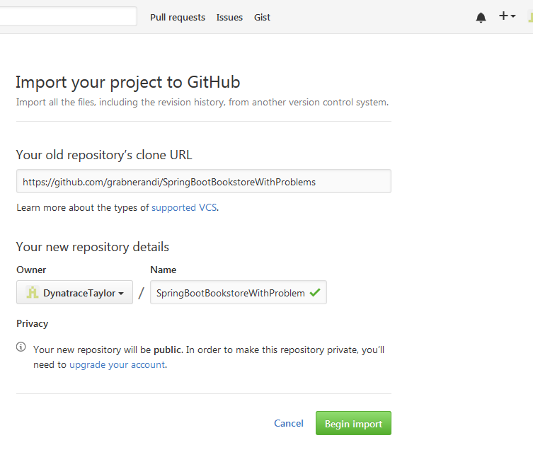
Participant requirements
GitHub Clone
Log into GitHub
Click on “+” sign in top right hand corner and select import repository.
In the “Your Old repository clone URL” copy this. https://github.com/grabnerandi/SpringBootBookstoreWithProblems
Give the repository a name SpringBootBookstoreWithProblems
Then click on Begin Import
When finished copy the link in the URL to a file because we will be using in the training
Notes:
Who has heard of OpenStack?
Who has worked with OpenStack?
Who has started a VM on AWS, VMWare, VirtualBox, ...?

Slide 6
Download Files from GitHub
https://github.com/grabnerandi/SpringBootBookstoreWithProblems/tree/master/pipeline
0PipelineBasic.txt
1PipelineRunAppNoDT.txt
2PipelineRunAppWithDT.txt
8WebAPITests.txt

Slide 7
Dynatrace Jenkins User Prepare – Step 1
IMPORTANT! Each user gets
an assigned Linux instance on AWS running Jenkins
A User for accessing a hosted Dynatrace AppMon instance
A Training Group assignment!

Slide 8
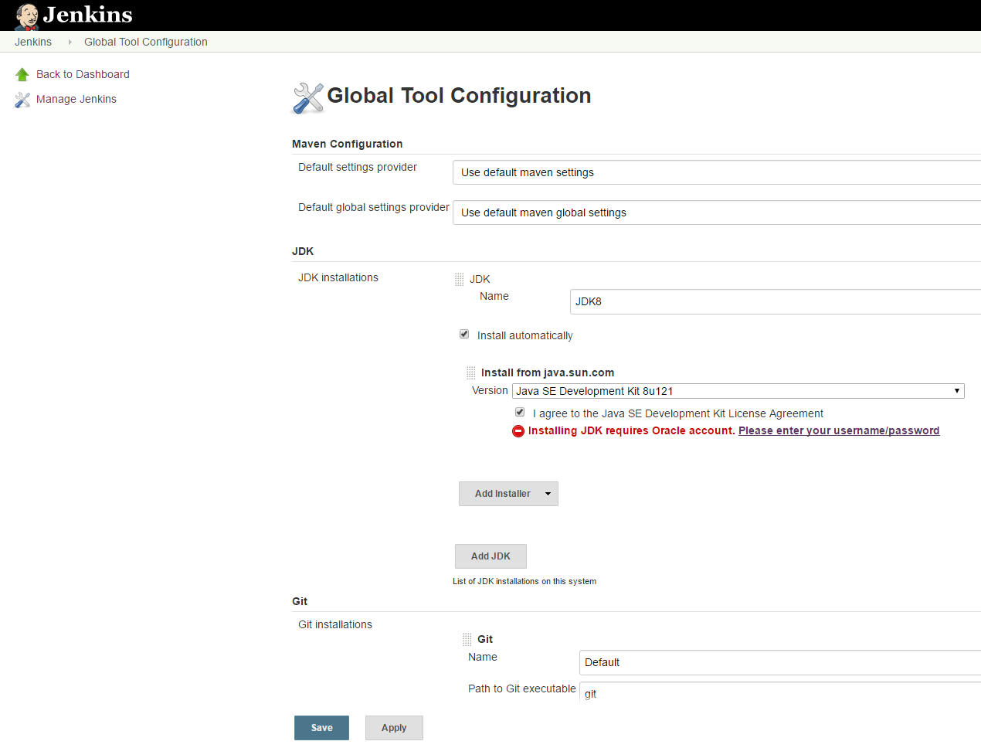
Dynatrace Jenkins User Prepare – Step 2
Access your Jenkins Instance on AWS
Browse to: http://yourjenkinsip:8080
User: dynajenkins
Pwd: dyn@trac3
Select MOST RECENT JDK from Oracle:
Jenkins -> Manage Jenkins ->
Global Tool Configuration

Slide 9
Dynatrace Jenkins User Prepare – Step 3
Access to your Dynatrace AppMon System Profile
Open your locally installed Dynatrace AppMon Client
Connect to the Dynatrace AppMon Server on 52.52.69.86
UserID has been provided to you. Something like AMGroupx or PMGroupx
Password is dyn@trac3
This user ID will have it’s own System Profile on the Dynatrace Server

Slide 10
What is Shift-Left Quality / Performance

Slide 11

A Delivery Pipeline DOES NOT PREVENT your teams from pushing bad code through the pipeline more frequently!
Dev&Test: Trial & Error Check-In Mentality!
Ops/Biz: Bad Code Changes make it to Production. Impact End Users and Resource Usage
Test / CI: Basic Tests that only test high-level functionality!
Performance: Too many code commits leads to skipping performance testing to save time
Notes:
Pipelines may lead to developers to start a „Trial & Error“ Mentality. Simply check in code and lets see how it works in production. They may even change unit tests so that they succesfully execute just in order to get through the pipeline. You may even see load tests being skipped just to make the deadline!

Slide 12
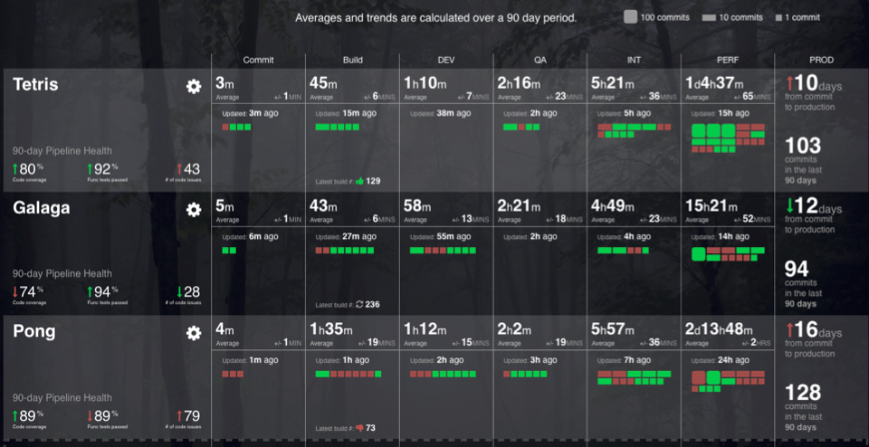
“To Deliver High Quality Working Software Faster“
„We have to Shift-Left Performance to Optimize Pipelines“
http://apmblog.dynatrace.com/2016/10/04/scaling-continuous-delivery-shift-left-performance-to-improve-lead-time-pipeline-flow/
Notes:
And this place nicely into what our friends from CapitalOne do to optimize their pipeline throughput: Shift Quality Left; Find problems earlier to avoid too many „bad builds“ wasting time in later pipeline stages that take longer to execute

Slide 13


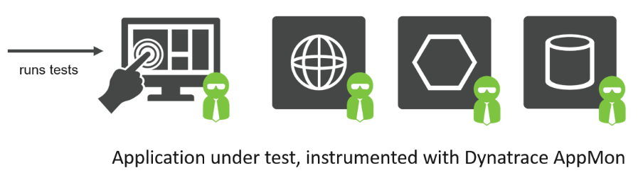









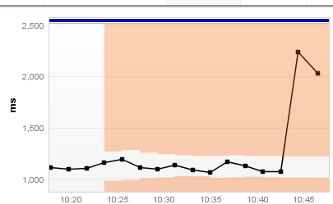
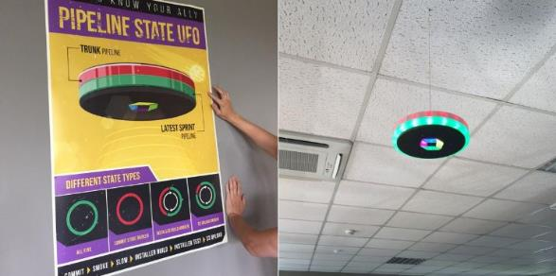
= Unit-, Integration-, WebAPI- & Functional Test Result (passed/failed)
+ Web Performance Metrics (# of Images, # of JavaScript, Page Load Time, ...)
+ App Performance Metrics (# of SQL, # of Logs, # of API Calls, # of Exceptions ...)
Auto Alert
Fail the build early!
Auto Baseline

Slide 14
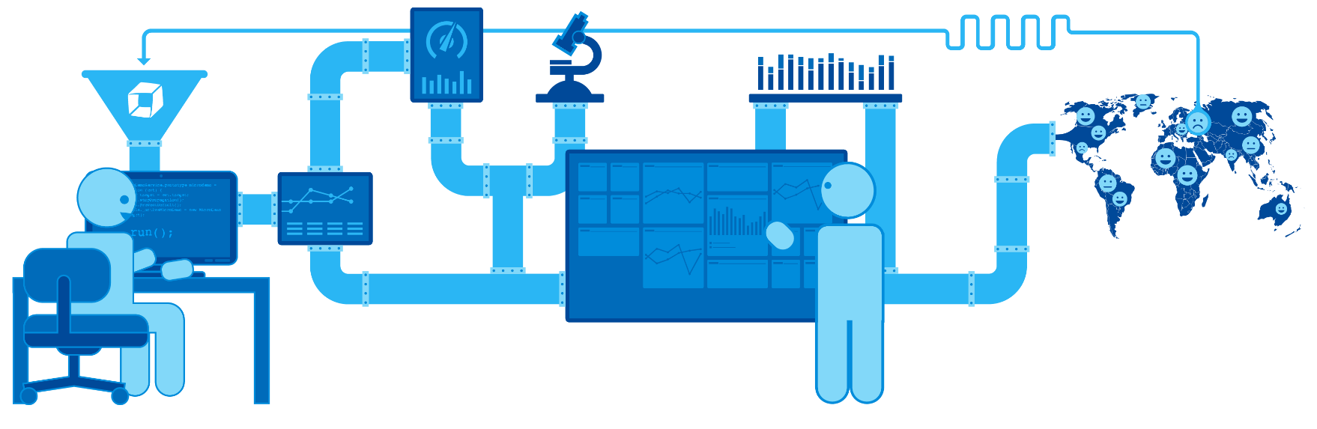
Reduce Lead Time: Stop 80% of Performance Issues in your Integration Phase
CI/CD: Test Automation (Selenium, Appium, Cucumber, Silk, ...) to detect functional and architectural (performance, scalabilty) regressions
Perf: Performance Test (JMeter, LoadRunner, Neotys, Silk, ...) to detect tough performance issues

Slide 15
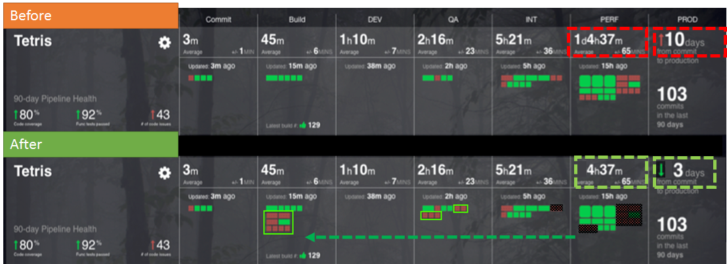
Shift-Left Performance results in Reduced Lead Time powered by Dynatrace Test Automation
http://apmblog.dynatrace.com/2016/10/04/scaling-continuous-delivery-shift-left-performance-to-improve-lead-time-pipeline-flow/

Slide 16
What we are trying to achieve today!

Slide 17
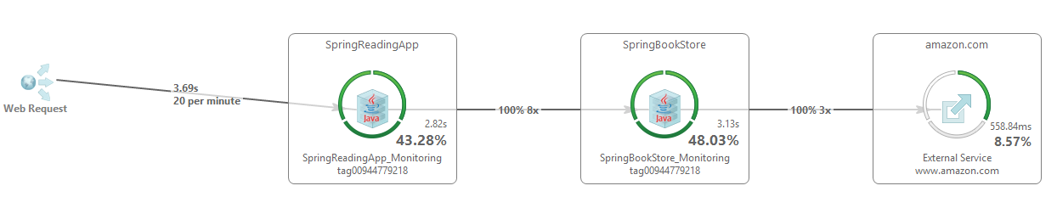
We have a 2-Tier Micro-Service App
Reading Application Endpoints
/to-read
/to-read/Fiction
/to-read/Computer
/to-read/AnyGenre
BookStore Application Endpoints
/recommended
/genres
/all
/all/Fiction
/all/Computer
/all/AnyOtherGenre

Slide 18
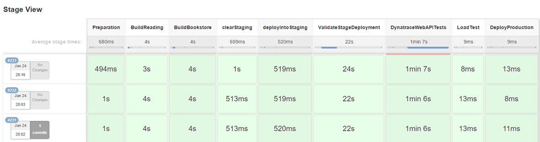
We are building, deploying and testing this application through Jenkins

Slide 19
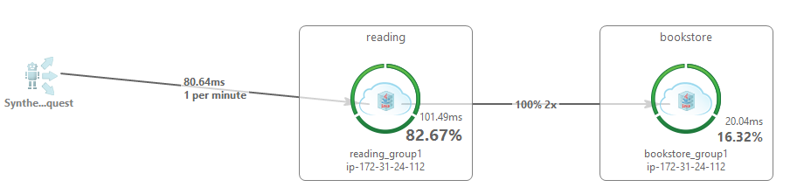
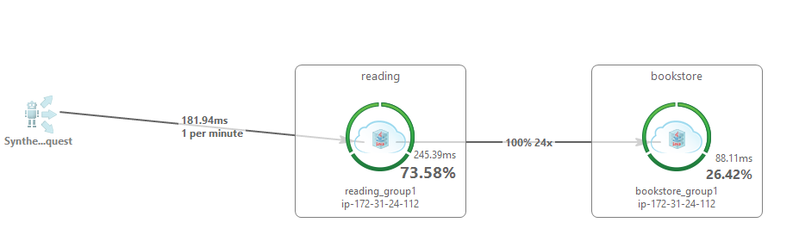
We are going to push 2 Versions of the App through our Pipeline
Version 1
Version 2

Slide 20
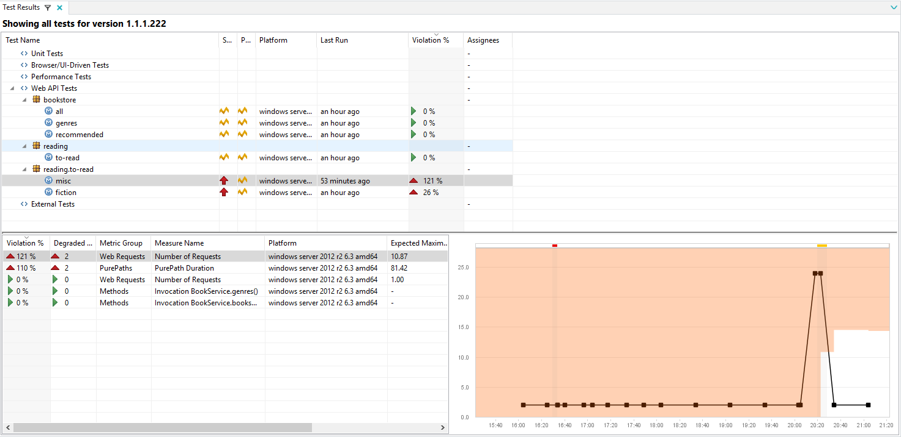
We are going to have Dynatrace Test Automation Detect that Regression
Regression Detected

Slide 21
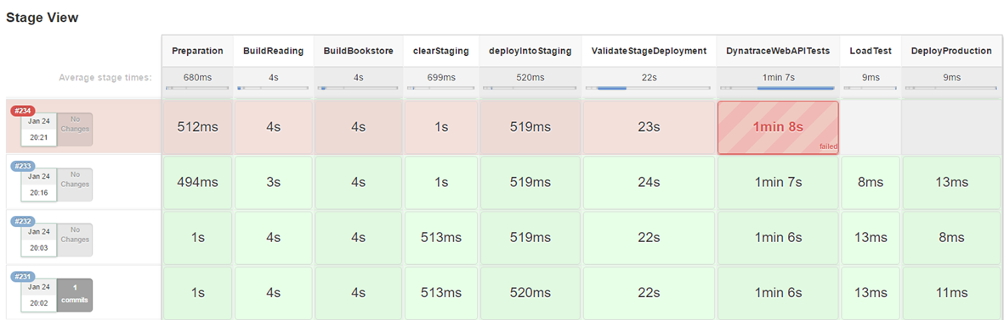
We are going to fail the Jenkins Pipeline BEFORE deploying this app in Production
Stop the Pipeline

Slide 22
Building our First Jenkins Pipeline
Goal #1: Build our first simple Pipeline
Goal #2: Full End-to-End Pipeline without Dynatrace

Slide 23
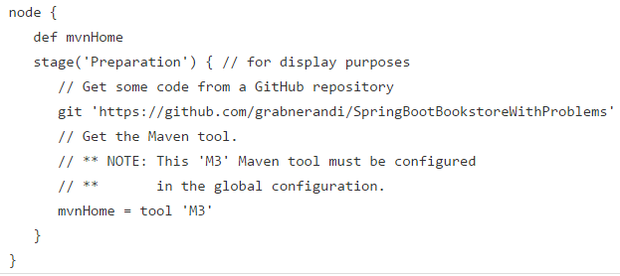
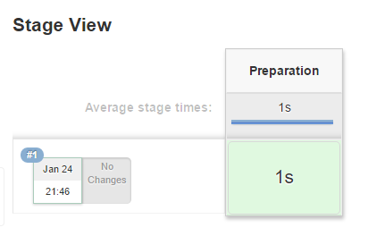
Goal #1: Creating your First Very Simply Pipeline From Scratch
We define a very simple pipeline
And see how it looks in Jenkins

Slide 24
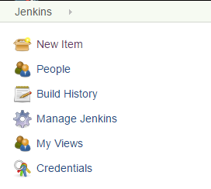
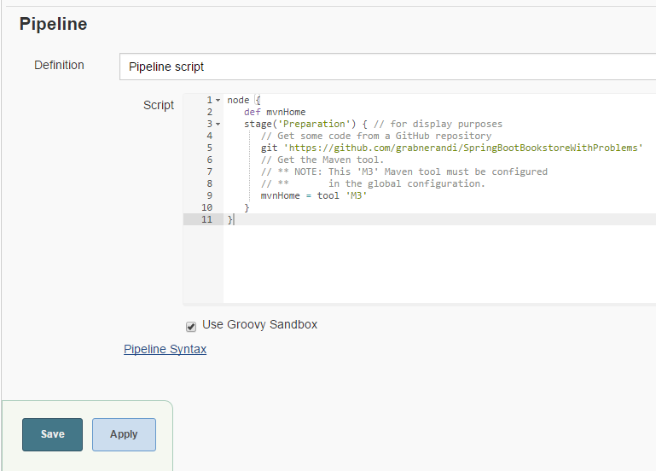
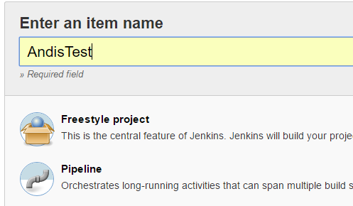
#1: Create a new “My Test Pipeline” project
1
4
‘https://github.com/YOURGIT/SpringBootstoreWithProblems’
4: Copy script from 0PipelineBasic.txt
Use your Git Repo Name
2
3
5

Slide 25
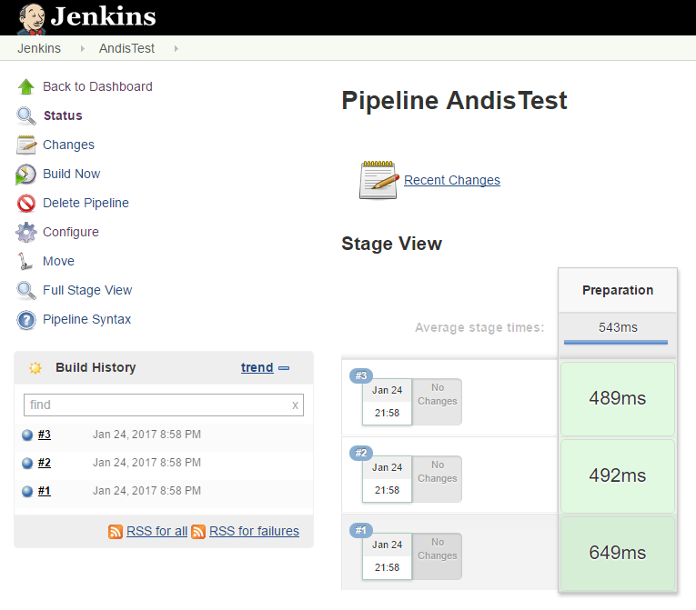
#1: Run the Pipeline
1: Build Now
2: Validate Runs
3: Explore a Run

Slide 26
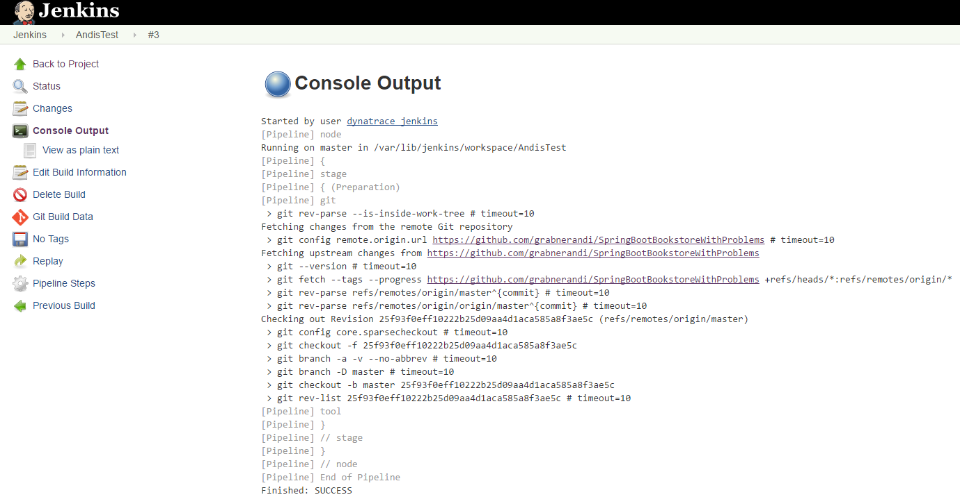
#1: Explore Run Details, e.g: for Troubleshooting
1: Console

Slide 27
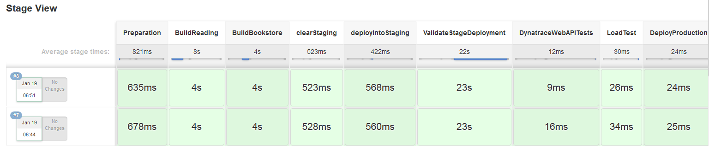
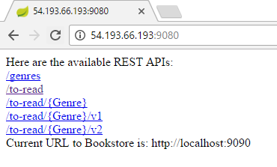
Goal #2: Create a Full End-to-End Pipeline & Access the Deployed App
We will define a full End-to-End Pipeline
And then access the deployed Application

Slide 28
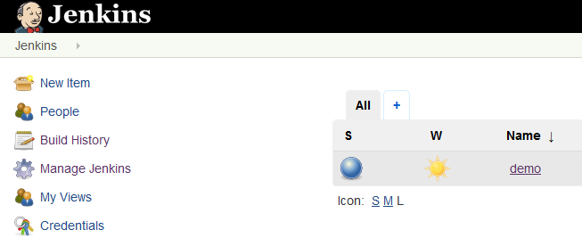
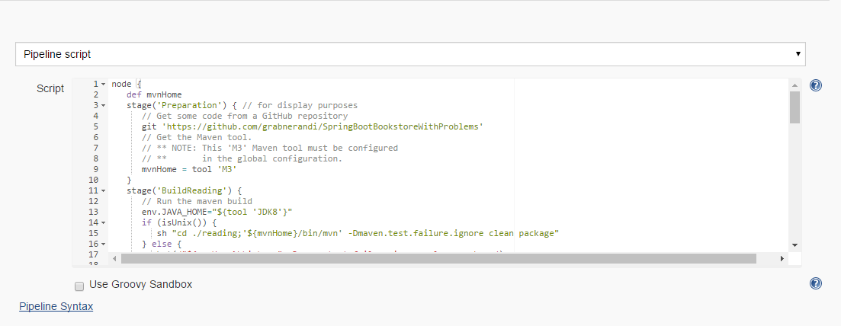
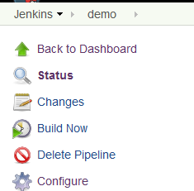
#2: Setup the Pipeline in the Demo Project
1
2
4
‘https://github.com/YOURGIT/SpringBootstoreWithProblems’
4: Copy script from 1PipelineRunAppNoDT and
replace existing! Use your Git Repo Name
3

Slide 29
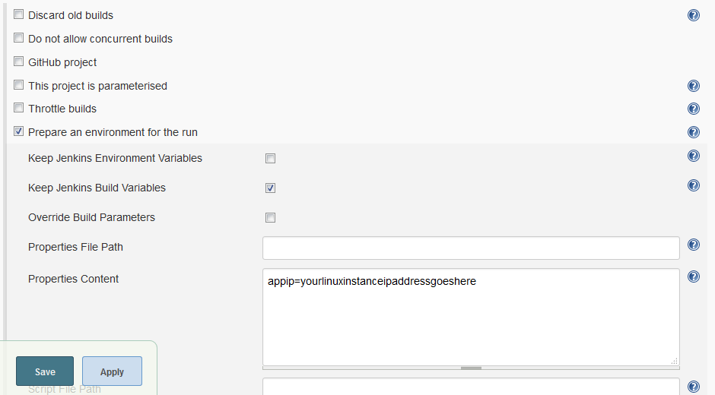
#2: Configure your Pipeline
Pipeline Scripts can use Properties, e.g: IP Addresses that will be used by our Test Scripts
1
1: appip=aa.bb.cc.dd
2

Slide 30
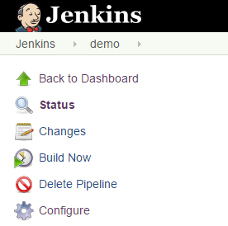
#2: Run the Pipeline & Access the Deployed Application
1
Access URL
http://yourappip:9080

Slide 31
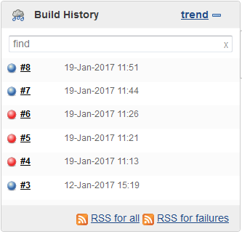
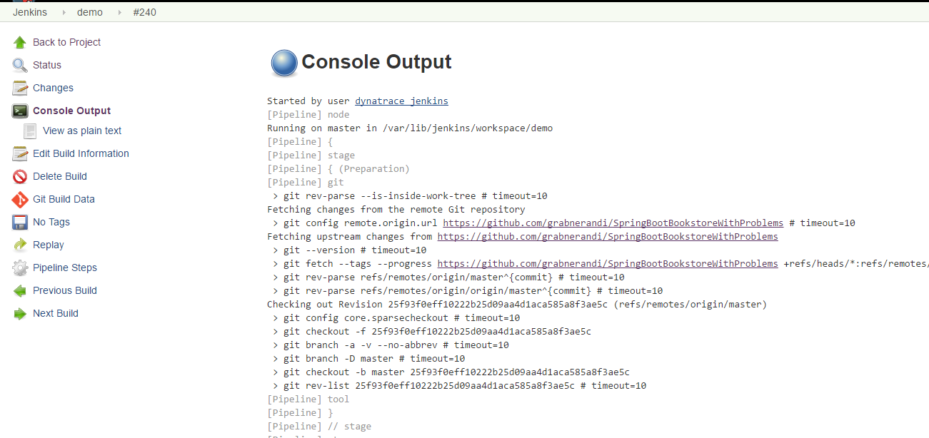
#2: Explore Run Details, e.g: for Troubleshooting
We can explore the console output for each run
1
2

Slide 32
Overview of our Spring Boot Micro-Service App
Goal #1: Understand the App and its Features

Slide 33
Goal #1: Explore the Sample Application and its Interfaces
Reading Application Endpoints
/
/version
/genres
/to-read
/to-read/Fiction
/to-read/Computer
/to-read/AnyGenre
/to-read/AnyGenre/v1
/to-read/AnyGenre/v2
BookStore Application Endpoints
/
/version
/recommended
/genres
/all
/all/Fiction
/all/AnyOtherGenre
/all/AnyGenre/v1
/all/AnyGenre/v2

Slide 34
#1: Configuration Options
reading/src/main/resources/application.properties
server.port=9080
bookstore.url=http://127.0.0.1:9090
reading.processingtime=500
Time in ms that each request will “need” to process the request: Implemented with Thread.sleep(time)
reading.version=1|2
Version 2 will show the N+1 Micro-Service Call Pattern for /to-read/<Genre>
We will be playing with that version field to “break the build”
Bookstore/src/main/resources/application.properties
server.port=9090
bookstore.processingtime=200
Time in ms that each request will “need” to process the request: Implemented with Thread.sleep(time)
bookstore.version=1|2
Version 2 will make calls to www.amazon.com in case it is a Genre other than Fiction, Thriller or Computer

Slide 35
#1: Explore the available endpoints
Reading Application Endpoints
/
/version
/genres
/to-read
/to-read/Fiction
/to-read/Computer
/to-read/AnyGenre
/to-read/AnyGenre/v1
/to-read/AnyGenre/v2
BookStore Application Endpoints
/
/version
/recommended
/genres
/all
/all/Fiction
/all/AnyOtherGenre
/all/AnyGenre/v1
/all/AnyGenre/v2

Slide 36
Dynatrace Test Automation Explained

Slide 37
Dynatrace Needs to Know Test Type, Test Name and Build #
#1: Tests per Category
#2: Tests for this Category
#4: Metrics Value for each Build
#3: Metrics Depend on Category
#5: “Baseline” Corridor for each Metric

Slide 38
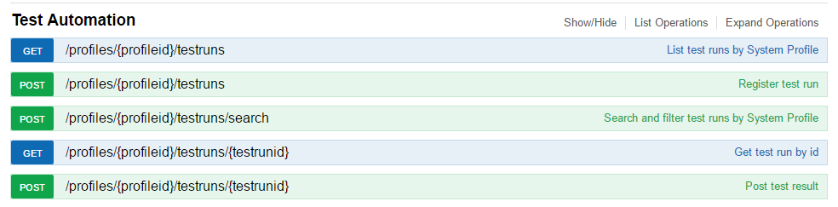
Test Automation Data is managed around Dynatrace Test Runs
Test Runs are registered & managed
Via REST -> or via existing Plugins for Jenkins, Bamboo, TFS
For a System Profile
For a particular Test Category: Unit, Performance (Unit), UI-Driven, Web API
For a particular Build (Major, Minor, Revision, Build #, additional name / value pairs)
Explore the REST API: https://52.52.69.86:8021/api-docs/current/index.html#/Test_Automation

Slide 39
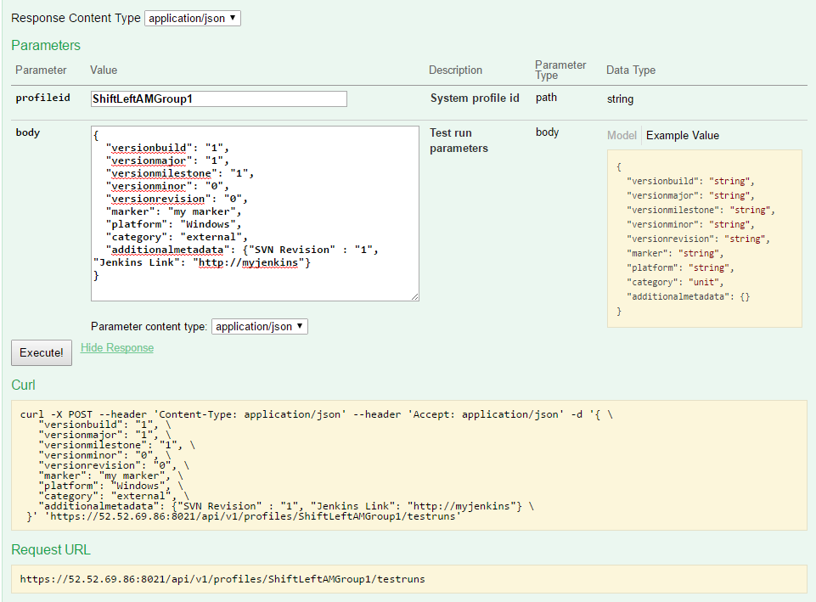
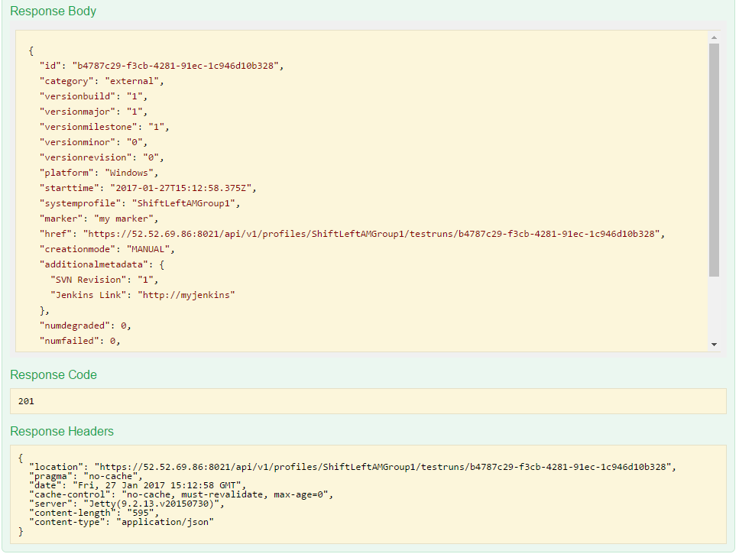
Sample: Registering a Test Run via REST to retrieve Test Run ID
System Profile
Test Run ID
Build Info
Test Category

Slide 40
Test Category defines which types of PurePaths are analyzed per Test Run …
Unit & Performance: PurePaths started by Unit Test Sensor
Test Name is taken from Test Method Name
Test Run ID must be passed to Java, .NET, PHP Agent that executes the Test
WebAPI: Tagged Web Requests
HTTP TN defines the Test Name
HTTP Header TR defines the Test Run ID
Agent itself MUST NOT be injected specially with any add. parameters!
UI-Driven: UEM Visits tagged with Test Run
Test Name and Test Run ID are passed through JavaScript ADK
Agents running on Application MUST NOT be injected specially with any add parameters!
Load Testing: NOT SUPPORTED IN TEST AUTOMATION FEATURE
Need to use “traditional” Load Testing Analysis and comparison

Slide 41
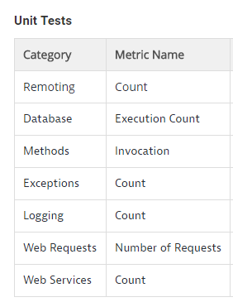
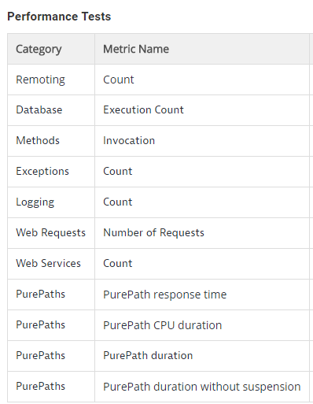
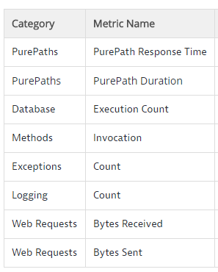
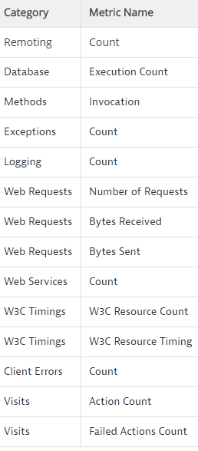
Test Category also defines which metrics are analyzed …
Unit Tests
Performance (Unit) Tests
Web API Tests
UI-Driven Tests

Slide 42
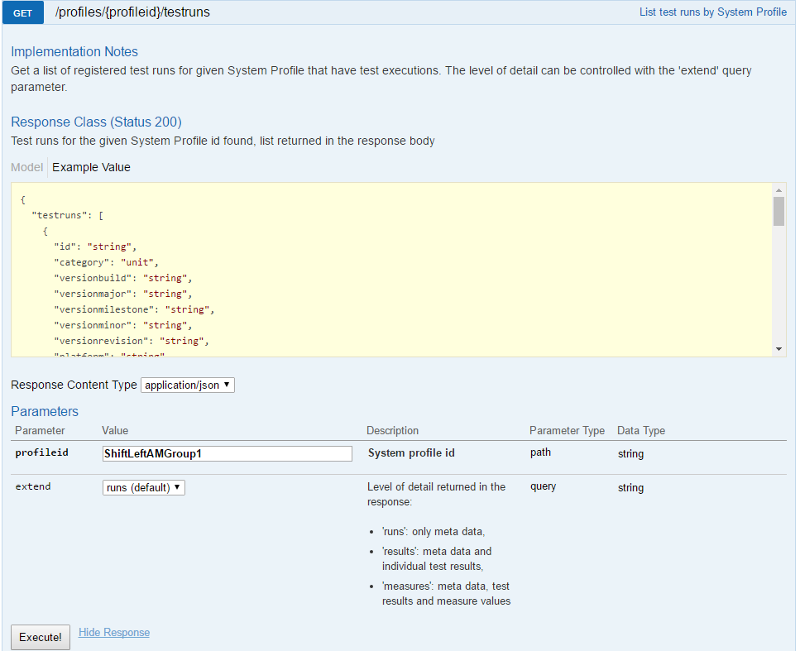
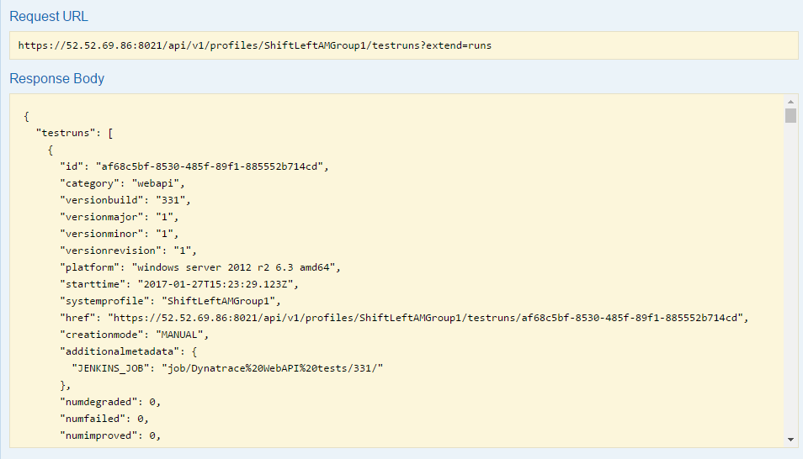
Retrieving Test Runs per System Profile
GET Test Runs
List of Test Runs
Sys Profile
How much detail?

Slide 43
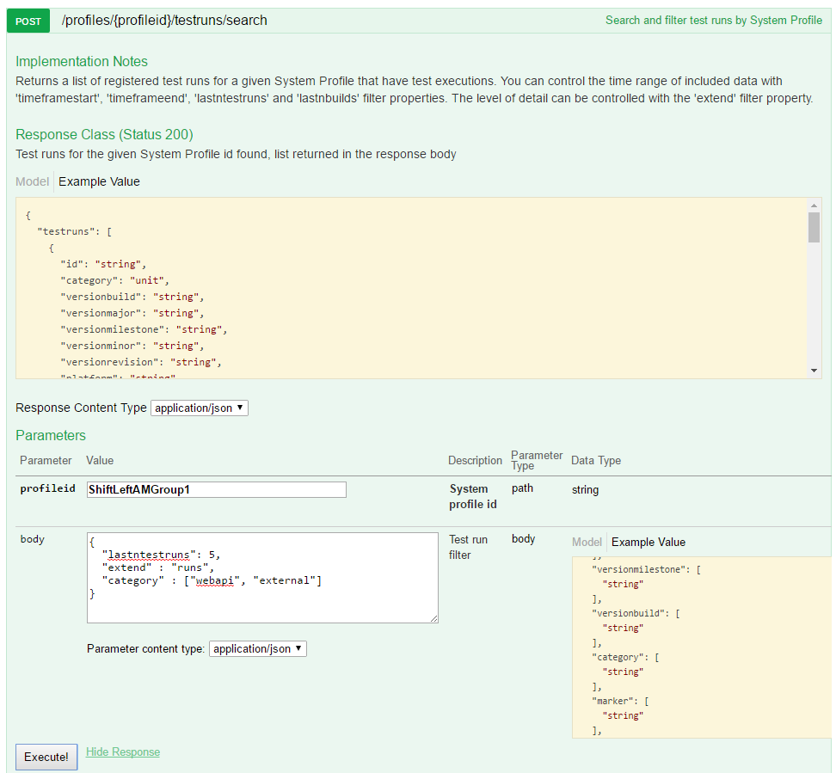
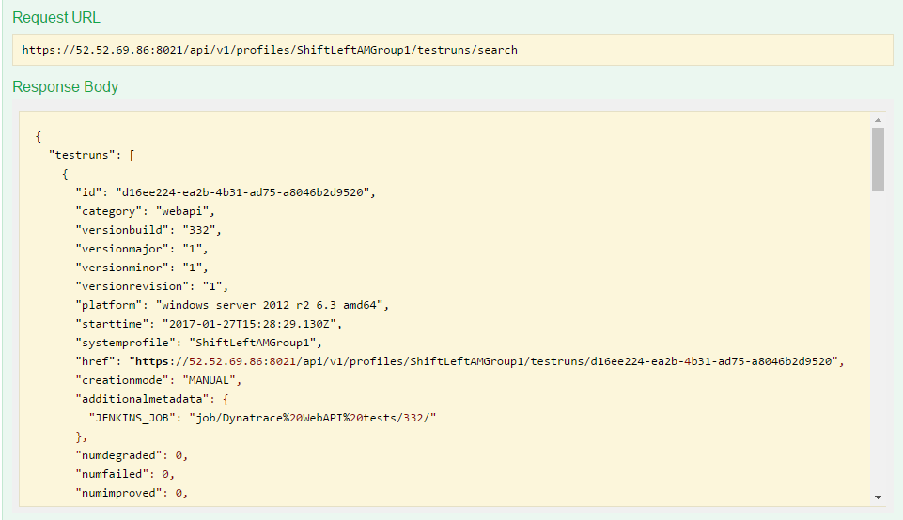
Search for specific Test Runs
POST Your Search
Search Result
System Profile
Search Query: Time, Builds, Category, Status, …

Slide 44
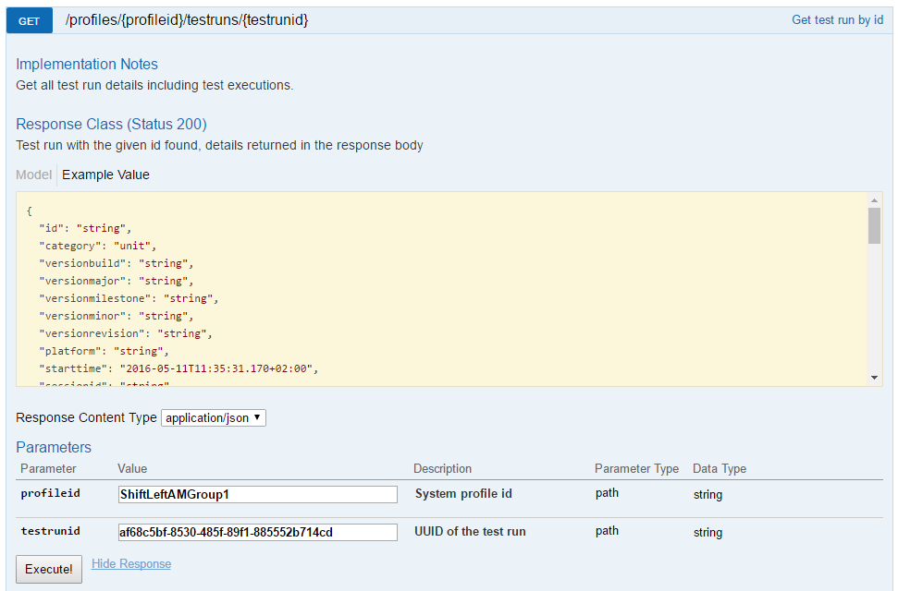
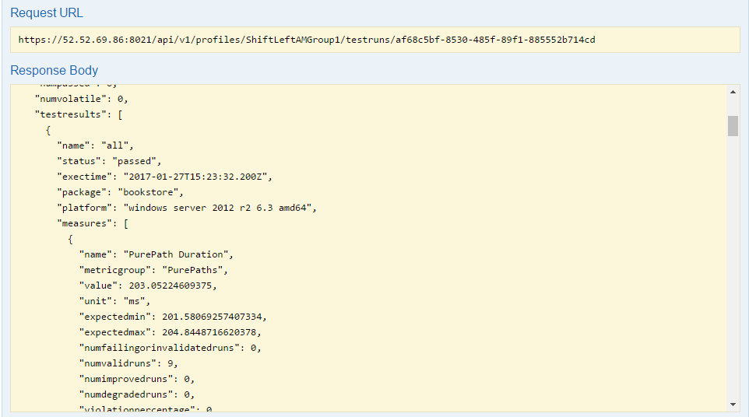
Retrieve Measures for a specific Test Run
GET details for a Test Run
All Tests, all Measures
System Profile + Test Run ID

Slide 45
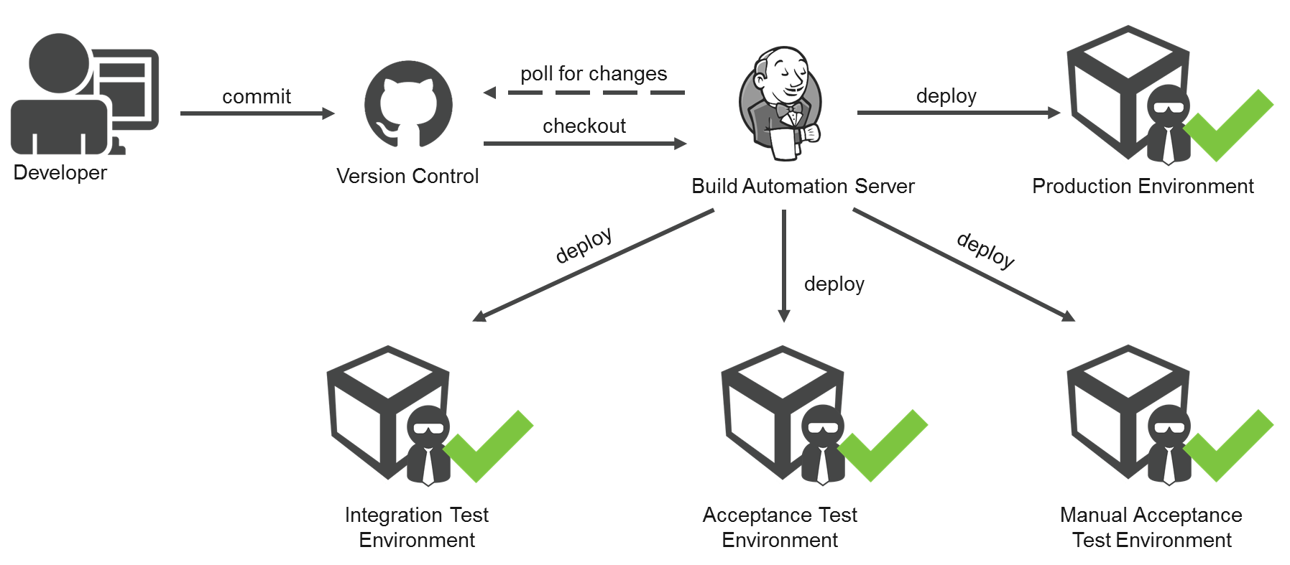
Continuous Delivery with Jenkins and Dynatrace

Slide 46
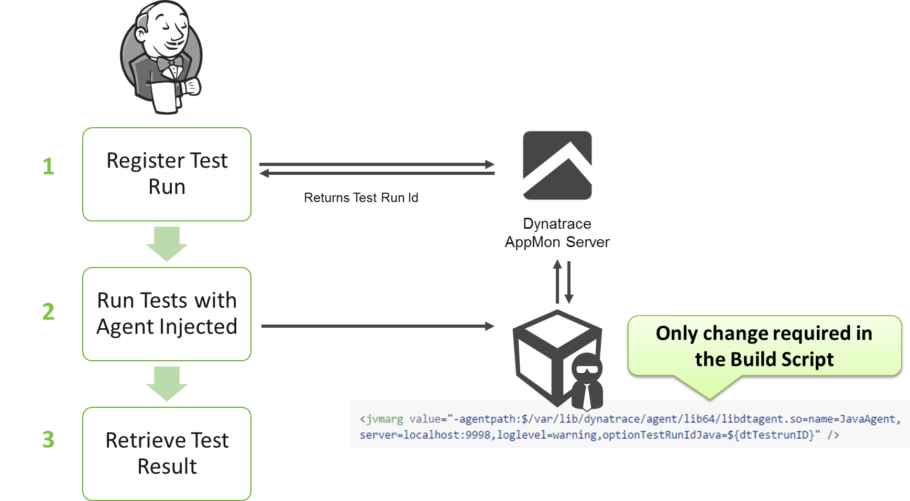
Option #1: Register Test Run in Jenkins and pass it to your Unit Test

Slide 47
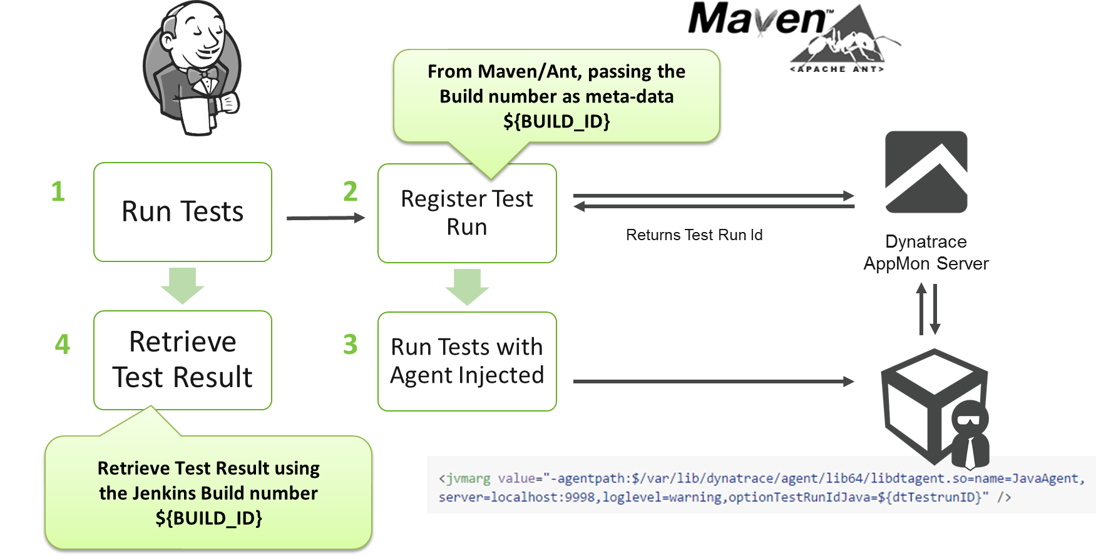
Option #2: Register Test Run in Maven/Ant and pass it to your Unit Test

Slide 48



For Web API Tests
Level-Up with Dynatrace
Deploy your App
Deploy your app instrumented with Dynatrace AppMon
Register WebAPI Test Run: Retreive <DT Test Run ID>
Run Tests
Pass Test Run ID to Test to add as HTTP Header: NA=Test Name;TR=<DT Test Run ID>
Run Tests
Analyze Results
Dynatrace provides Results

Slide 49

For UI-Driven Tests
Level-Up with Dynatrace
Browse to URL
Browse to URL instrumented with Dynatrace UEM
Tag Session with Test Name. (optional) Test Run ID
sessionStorage.DT_TESTNAME=“Tests.MyApp.HomepageTest“;
sessionStorage.DT_TESTRUNID = “<TEST RUN ID FOR BUILD>“;
Run Test
Run Test
End Visit
(optional) Functional Status
sessionStorage.DT_TESTRUN_SUCCESS = “Functional Success??“;
dynaTrace.endVisit();
Close Browser
Close Browser

Slide 50
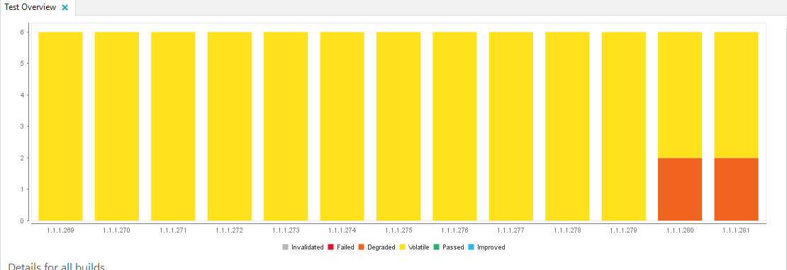
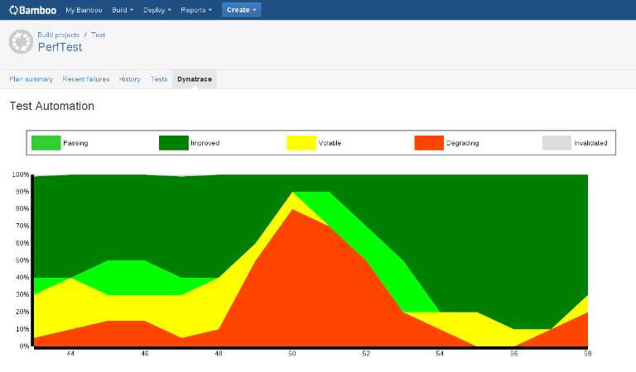
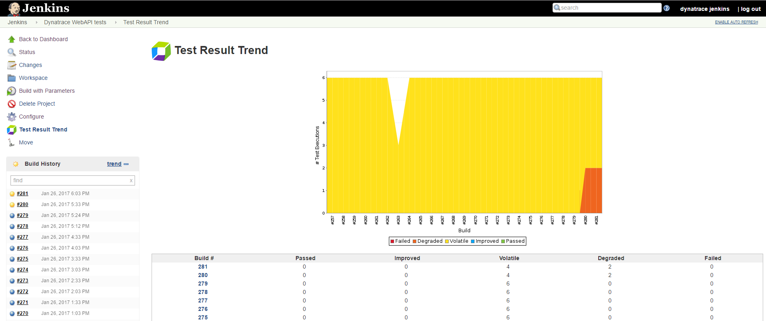
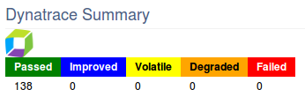
Build-Level Data in Dynatrace, Jenkins, Bamboo, …

Slide 51
Integrate Dynatrace into our Pipeline
Goal #1: Injecting Dynatrace Agents Goal #2: Executing Web API Tests from Jenkins Goal #3: Enable Dynatrace Test Automation

Slide 52


Goal #1: Inject Agents into our Java Application
1: Will Inject Agents
2: Will Capture PurePaths

Slide 53
#1: Inject Dynatrace Agents into the Java Command Line
1
2
4
‘https://github.com/YOURGIT/SpringBootstoreWithProblems’
4: Copy script from 2PipelineRunAppWithDT and
replace existing! Use your Git Repo Name
3

Slide 54


#1: How does the injection actually work and how we parameterized it
#1: Define your Agent Names and Dynatrace Server IP
#2: The –agentpath configuration picks it up

Slide 55

#1: Run the Pipeline, Validate Agents are connected and PurePaths collected
2: Will Inject Agents
3: Will execute 2 Web Requests
1
4: Validate PurePaths are here!

Slide 56


Goal #2: Running Web API Tests to see Tagged Web Requests
#1: We will execute HTTP Tests using WGET and standard HTTP Tagging
#2: We will see Tagged Web Requests in Dynatrace
Notes:
wget http://${appip}:9080/to-read -d --header="x-dynatrace: NA=reading.to-read"
wget http://${appip}:9080/to-read/Fiction -d --header="x-dynatrace: NA=reading.to-read.fiction"
wget http://${appip}:9080/to-read/Misc -d --header="x-dynatrace: NA=reading.to-read.misc"
wget http://${appip}:9090/recommended -d --header="x-dynatrace: NA=bookstore.recommended"
wget http://${appip}:9090/genres -d --header="x-dynatrace: NA=bookstore.genres"
wget http://${appip}:9090/all -d --header="x-dynatrace: NA=bookstore.all"

Slide 57

#2: Add a new Jenkins Job that executes Web API Tests
Click on “Jenkins” to go back home
Click on “New Item”
Create a new Job with the name “Dynatrace WebAPI tests” and make it a “Freestyle project”
1
2

Slide 58

#2: Make “Dynatrace WebAPI Test” Job Parameterized, e.g: pass IP Address
We make it a “parameterized” project and add a String Parameter
1
2
3

Slide 59

#2: Make “Dynatrace WebAPI Test” Job Parameterized, e.g: pass IP Address
String parameter “appip” with default value “localhost”
1

Slide 60

#2: Invoking the Web API Test Cases. In our case – simple WGET commands!
1
Click on Add build Step and select “Execute shell”
In the command section add this text below. Adding will test out the URL and add a x-dynatrace header and test run ID to the URL. You could also do this with SOAP UI, or Jmeter to name a couple.
2
3
wget http://${appip}:9090/recommended -d --header="x-dynatrace: NA=bookstore.recommended"
wget http://${appip}:9090/genres -d --header="x-dynatrace: NA=bookstore.genres"
wget http://${appip}:9090/all -d --header="x-dynatrace: NA=bookstore.all"
wget http://${appip}:9080/to-read -d --header="x-dynatrace: NA=reading.to-read"
wget http://${appip}:9080/to-read/Fiction -d --header="x-dynatrace: NA=reading.to-read.fiction"
wget http://${appip}:9080/to-read/Misc -d --header="x-dynatrace: NA=reading.to-read.misc"
Notes:
wget http://${appip}:9090/recommended -d --header="x-dynatrace: NA=bookstore.recommended"
wget http://${appip}:9090/genres -d --header="x-dynatrace: NA=bookstore.genres"
wget http://${appip}:9090/all -d --header="x-dynatrace: NA=bookstore.all"
wget http://${appip}:9080/to-read -d --header="x-dynatrace: NA=reading.to-read"
wget http://${appip}:9080/to-read/Fiction -d --header="x-dynatrace: NA=reading.to-read.fiction"
wget http://${appip}:9080/to-read/Misc -d --header="x-dynatrace: NA=reading.to-read.misc"

Slide 61

#2: “Test” the new Job Execution
2: Either localhost or your IP
1
3: Validate in Dynatrace

Slide 62

#2 Extended: Invoke the new Web API Tests from our main Pipeline
Edit the Configuration for your Demo Pipeline Project
Uncomment these 3 lines
Uncheck!

Slide 63


Goal #3: Enable Dynatrace Jenkins Integration
#1: We will install and configure the Dynatrace Jenkins Plugin
#2: We will see Dynatrace Test Automation Data in Jenkins

Slide 64

#3: Enable Dynatrace Jenkins Integration – Install Plugin Option 1
There are 2 ways to download and install the Dynatrace Jenkins Plugin, start off by reading about it here if your wish https://wiki.jenkins-ci.org/display/JENKINS/Dynatrace+Plugin
The easiest is to go to Manage Jenkins, and select Manage Plugins, please do it this way.
1

Slide 65
#3: Enable Dynatrace Jenkins Integration – Install Plugin Option 1
Then click on the Available tab and select Dynatrace Application Monitoring Plugin and restart.
1

Slide 66


#3: Enable Dynatrace Jenkins Integration – Install Plugin Option 2
The other option is to go to gitHub to download the plugin here https://github.com/jenkinsci/dynatrace-plugin
Scroll down to releases and download the latest release
Then click and download the Dynatrace-dashboard

Slide 67

#3: Enable Dynatrace Jenkins Integration – Install Plugin Option 2
in Jenkins, click on "Manage Jenkins" / "Manage Plugins"
click on the "Advanced" tab
upload the plugin (dynatrace-dashboard.hpi) in the section "Upload Plugin"
restart Jenkins when the installation is complete

Slide 68

#3: Enable Dynatrace Jenkins Integration – Configure Plugin
To validate go to Manage Jenkins, select Configure system
Change the IP address to the Dynatrace Server 52.52.69.86 and then click on the advanced button and increase the timeout from 10 to 60 seconds. Also uncheck the validate certificates for this lab. Also change the user to YOURUSERNAME whatever your account is on the Dynatrace server.
Then click on the test button, you should get connection successful. Then click on Save and you are done, you have a connection to the Dynatrace server.
1
2
3
uncheck
4
YOU WILL NEED TO TEST OUT THE PARTICIPANT ACCOUNT

Slide 69

#3: Enable Dynatrace for our Dynatrace WebAPI Jenkins Job
Go back to your “Dynatrace WebAPI Test” and click configure
Scroll down to “Build Environment” and select “Use Dynatrace AppMon to monitor tests”
Then type in your system profile name based on your group for example ShiftLeftAMGroup1, ShiftLeftAMGroup2, ShiftLeftAMGroup3, etc…
Then click on test connection if successful, happy day. Then add a 1 to the remaining values (Version Major, minor, revision. Should look like this.
1
2
4
3

Slide 70


#3: Register Dynatrace Test Run PRIOR to executing the Web API Tests
Add a Build Step for “Dynatrace – Register Test Run”
Move it BEFORE our Execute Shell
Select “webapi” as Test Category
Add $dtTestrunID to each wget
1
2
3
4
Notes:
wget http://${appip}:9080/to-read -d --header="x-dynatrace: NA=reading.to-read;TR=$dtTestRunID"
wget http://${appip}:9080/to-read/Fiction -d --header="x-dynatrace: NA=reading.to-read.fiction;TR=$dtTestRunID"
wget http://${appip}:9080/to-read/Misc -d --header="x-dynatrace: NA=reading.to-read.misc;TR=$dtTestRunID"
wget http://${appip}:9090/recommended -d --header="x-dynatrace: NA=bookstore.recommended;TR=$dtTestRunID"
wget http://${appip}:9090/genres -d --header="x-dynatrace: NA=bookstore.genres;TR=$dtTestRunID"
wget http://${appip}:9090/all -d --header="x-dynatrace: NA=bookstore.all;TR=$dtTestRunID"

Slide 71


#3: Pull Dynatrace Test Automation Data BACK into Jenkins
Next add a post build action, select “Dynatrace AppMon – Publish Test Results”
Click modify the build status on degraded tests, degraded tests change build stats to UNSTABLE is selected by default. Select print XML for debugging just in case
2
1
3

Slide 72



#3: RUN IT!
Lets run the FULL Pipeline
2: Will now run much longer!
1
3: WebAPI Job will show Dynatrace results

Slide 73

#3: Validate Results in Dynatrace
1: Every Test
2: Metrics per Test
3: Value for Test & Metric

Slide 74
Lets Break the Build
Goal #1: Run many tests to establish a baseline
Goal #2: Make a bad code change and break the build
Goal #3: Change back to good version

Slide 75

Goal #1: Establish a Baseline!
#1: We will run the Test multiple times to get a baseline!

Slide 76

#1: Establish a Baseline! Lets RUN the Pipeline every 5 Minutes!
In “Demo” project enable Build Periodically with: H(0-59)/5 * * * *
After a while we should see more builds!
1
3
GO ON A BREAK ☺
2
4

Slide 77
#1: Validate the Baseline!
Validate you have more results now in Dynatrace
Volatile is OK b/c of AWS small instances
Validate Builds

Slide 78


Goal #2: Break the Build: Lets Deploy Version 2 of our Reading Application
#1: We will change the source code
#2: We will see the Pipeline stop!
1: Change the Version
See it FAIL!

Slide 79


#2: Lets Change Version to Version 2
Go to your own GitHub Repository and navigate to /reading/src/main/resources/application.properties
1: Edit
2: Change to “2”
3: Comment
4: Commit

Slide 80


#2: Watch Dynatrace Detect Regressions in Dynatrace

Slide 81

#2: See the Regression failing the Pipeline in Jenkins

Slide 82


Goal #3: Change back to GOOD version!
#1: Change back to Version 1
#2: See the Pipeline goes back to Green

Slide 83
Advanced Options: Custom Metrics, Feature Flagging, Test Automation Settings, External Test Results

Slide 84

All Metrics must be Split for each Agent
That is true for the out-of-the-box metrics as well as custom metrics
PurePath Duration, Exception Count, Web Request Count, …
Custom Method Invocation, Database Count, Database Time, …
2: Details Tab
1: Edit Measure
3: For each agent

Slide 85

Goal #1: Custom Metrics
Instrument BookService.genres and BookService.booksByGenre and define Invocation Measure
TIP: Measure must be configured to deliver values per Agent!
1: Metrics

Slide 86

Goal #2: Capture Version Number of Application
Instrument toReadImpl and capture version parameter
TIP: Create a BT that splits by this version parameter
Allows you to also use this for A/B or Blue/Green Deployment Testing and Monitoring

Slide 87

Background Information: Test Automation Settings
https://community.dynatrace.com/community/display/DOCDT65/System+Profile+-+Test+Automation
1: Enable & Configure UEM-based Testing
2: When to mark a test degraded
“Rolling Window”: Last X Test Runs to impact Corridor

Slide 88

Options in the Test Automation Result Dashlet
Assign to a Dynatrace User
Test Violation Incident will be sent to this user
Ignore last test execution for status and corridor
Useful when you had an environment issue
Accept all metrics as GOOD
This will restart corridor calculation from here
Delete Test Result
Useful when it was a bad build overall
1
2
3
4

Slide 89

Options in the Test Automation Result Dashlet
Compare this build with the previous
Opens Comparison Dashboard
Compare with a second selected build
You can multi select with pressed Ctrl-Key
Ignore last test execution for status and corridor
Useful when you had an environment issue
Accept THIS metric as GOOD
This will restart corridor calculation from here
1
2
3
4

Slide 90

External Result REST API: Use Dynatrace as Test Result Repository!
Feeding any external Test Data into Dynatrace
External Test Type
External Measures
Value + Corridor

Slide 91
External Test Data REST API: Register your External Test
System Profile
Test Run ID
Build Info
“External” Test Category

Slide 92

Feeding External Test Data to Test Run
POST Test Results
Profile + Test Run ID
Test Name: A.B.C.xxx
List of Measures:
Value, Min, Max, Color …

Slide 93
Final Thoughts

Slide 94
More Resources on other Pipelines
Video Tutorials:
Eclipse & Jenkins: https://www.youtube.com/watch?v=p4Vh6BWlPjg&t=77s&index=42&list=PLqt2rd0eew1bmDn54E2_M2uvbhm_WxY_6
Selenium & SauceLabs: https://www.youtube.com/watch?v=-OSSKwD4WKQ&t=2s&index=50&list=PLqt2rd0eew1bmDn54E2_M2uvbhm_WxY_6
Unit Testing: https://www.youtube.com/watch?v=TXPSDpy7unw&t=3s&index=38&list=PLqt2rd0eew1bmDn54E2_M2uvbhm_WxY_6
AWS CodePipeline: https://www.youtube.com/watch?v=tb4xJ5im8jw&t=2s&index=61&list=PLqt2rd0eew1bmDn54E2_M2uvbhm_WxY_6
More Online Resources
Test Automaton Samples: https://github.com/Dynatrace/Dynatrace-Test-Automation-Samples
Bamboo Integration: https://marketplace.atlassian.com/plugins/be.sofico.bamboo.plugins.bamboo-dynatrace-plugin/server/overview
TFS Integration: https://github.com/Dynatrace/Dynatrace-AppMon-TFS-Integration-Plugin
Load Testing Comparison Plugin: https://community.dynatrace.com/community/display/DL/Performance+Signature+Plugin

Slide 95

Our Partner Electric Cloud

Slide 96










Escape the War Room
Powered by Dynatrace Guardian
30 minute timer
Crack the puzzles
Avoid the NOC Zombie
Locked in a room
Follow the clues
Solve the outage
Escape the war room

Slide 97



Escape the War Room
Powered by Dynatrace Guardian
Escape within 30 minutes -- earn a free t-shirt
Fastest team to escape -- earn a free Amazon Echo Dot
Limited Availability
Monday
6PM, 7PM, 8PM
Wednesday
6PM, 7PM, 8PM, 9PM
Register Now!!!
Mobile App
bit.ly/performescape

Slide 98
Not required for Class but very useful for standing up Jenkins from Scratch on Linux on AWS

Slide 99
Jenkins Install on Ubuntu on AWS
NOT REQUIRED FOR CLASS BUT IF YOU WANT TO DO FROM SCRATCH
Prerequisite
https://wiki.jenkins-ci.org/display/JENKINS/Installing+Jenkins+on+Ubuntu
apt-get install openjdk-8-jdk
http://askubuntu.com/questions/761127/how-do-i-install-openjdk-7-on-ubuntu-16-04-or-higher
wget -q -O - https://pkg.jenkins.io/debian/jenkins-ci.org.key | sudo apt-key add - sudo sh -c 'echo deb http://pkg.jenkins.io/debian-stable binary/ > /etc/apt/sources.list.d/jenkins.list' sudo apt-get update sudo apt-get install jenkins
Start Jenkins
service jenkins start/stop/restart
Ps –ef |grep Jenkins to see if it is running
Notes
Jenkins is in /etc/init.d, /etc/default/
libraries are in /var/lib/jenkins
Logs are in here /var/log/Jenkins
Jenkins starts on port 8080. If you are using AWS make sure the firewall ports are open. Otherwise the port may be blocked
Connect to Jenkins http://youripaddress:8080/jenkins

Slide 100



Jenkins Install on Ubuntu on AWS
You will be prompted for a certificate on first access. Follow the instructions to activate you will have to grab a string value from a file (initialAdminPassword) in a directory under /var/lib/jenkins/secrets. Enter this value, and If you get an error HTTP 404 not found go back to the root URL http://youripaddress:8080 and hit enter. Trust me this one was hard to trouble shoot. I just saved you hours of time.
This is the error you may get
This is how you fix it just remove Jenkins at the end of the URL http://yourIPaddress:8080/ .
This is what you should see select Install Suggest Plugins

Slide 101


Jenkins Install on Ubuntu on AWS
You

Slide 102

Jenkins Install on Ubuntu on AWS
You create a new project, give it a name and select Pipeline

Slide 103


Jenkins Install on Ubuntu on AWS
Then select manage Jenkins and click on Global Tool Configuration
Expand JDK and type in JDK8

Slide 104


Jenkins Install on Ubuntu on AWS
Still within the Global configuration scroll down to Maven and type in M3
The go back to you pipeline project and this to your pipeline, indentation should look like image. Then click on Save at the bottom of project
Node {
def mvnHome
stage('Preparation') { // for display purposes
// Get some code from a GitHub repository
//git 'https://github.com/grabnerandi/SpringBootBookstoreWithProblems'
git 'https://github.com/grabnerandi/SpringBootBookstoreWithProblems'
// Get the Maven tool.
// ** NOTE: This 'M3' Maven tool must be configured
// ** in the global configuration.
mvnHome = tool 'M3'
}
}
Note: Uncheck Groovy Sandbox

Slide 105

Jenkins Install on Ubuntu on AWS
Then back at the main Jenkins screen for your project click on Build now and watch the magic of your first project down the code from GitHub.

Slide 106

Jenkins Install on Ubuntu on AWS
Environment Injector Plugin add to plugins
Click on Manage Jenkins, Click on Plugins and search for Environment Injector Plugin. Then Click Download now and install after reboot. This plugin allows you to pass properties to the pipeline

Slide 107
Jenkins Install on Ubuntu on AWS add Dynatrace agent
Download the dynatrace agent onto Linux
Java – jar into the /opt/dynatrace directory

